Slide 1
Bank Marketing Campaign Analysis
By: Kumaran Ragunathan

Slide 2




Goals
Values
Predict the clients who subscribe to term deposit
Increase customer base
Identify potential clients for marketing campaign
Reduce marketing cost and time

Slide 3


Dataset
41188 records with 20 variables
9 categorical , 10 numerical variables
11.7% customers subscribed to term deposit
Highly imbalanced dataset
Dropped variables
Duration
Duration is determined after the call is made
Campaign
Number of contacts made during this campaign

Slide 4




Findings
65%
previous customers subscribed to new term
45%
people with age over 60 subscribed
Retired and students
responded positively to the campaign
15%
Success rate with cellular communication

Slide 5

Process
Data cleaning
Missing values ("job", "marital", "education", "default", "loan")
Outliers (“age”, “previous”)
Pdays converted to categorical variable
Data Preprocess
Dataset balance
Optimizing
Balanced dataset using SMOTE
Hyper parameter tuning
Grid Search with cross validation
Classifiers
Evaluation
Logistic Linear Regression
Decision Tree
KNN classifier
Random Forrest
AdaBoost
Gradient Boost
XGBoost
Precision
Recall
F1-score
AUC-ROC

Slide 6



Findings
XGBoost model showed best performance with AUC 65%
“Number of employees” financial indicator is an important feature
Balancing dataset improved performance of classifiers

Slide 7

Recommendations
Prioritize previously deposited clients
Older people tend to respond more positively to campaigns
Financial indicators impact on decisions
Prefer cellular as way of communication

Slide 8
Thank You…!!

Slide 9
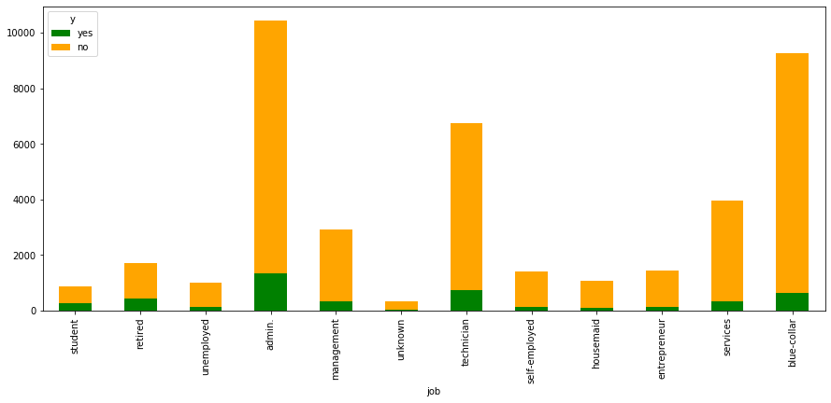
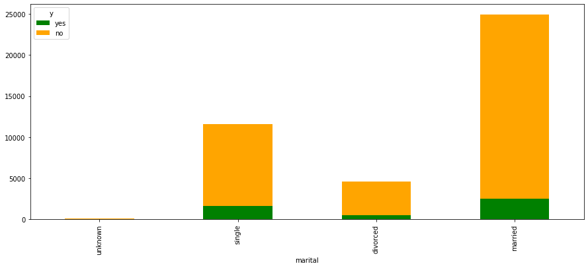
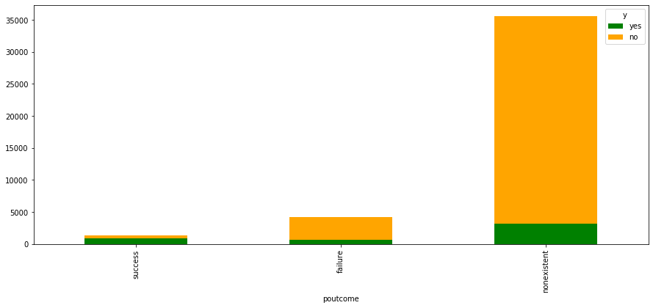
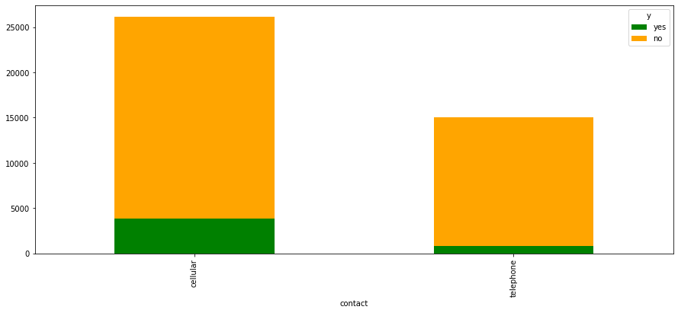
Feature values distribution

Slide 10
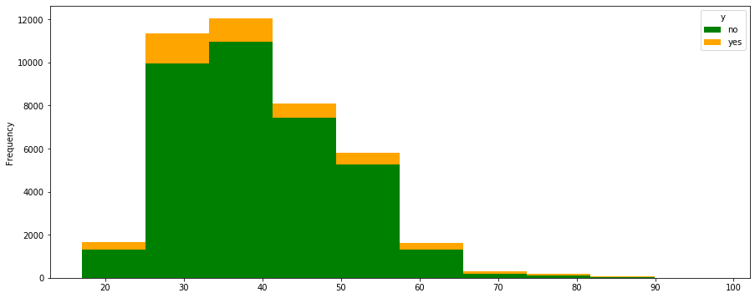
Age
Clients with age less than 60 : 10.42 % subscribed
Clients with age greater than 60 : 45.49% subscribed

Slide 11
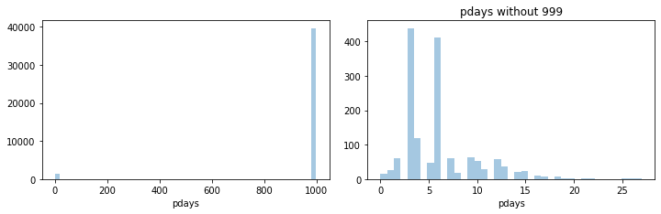
pdays

Slide 12
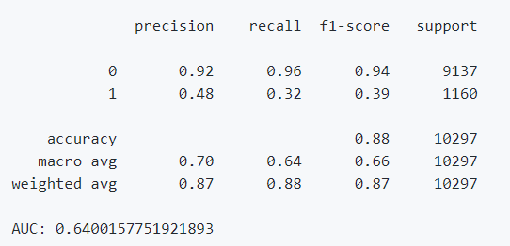
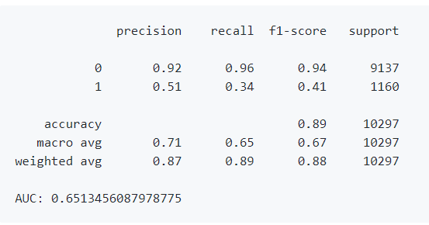
Classifier
Gradient Boost
classifier | f1-score
GradientBoostingClassifier | 0.475578
XGBClassifier | 0.473210
AdaBoostClassifier | 0.462191
LogisticRegression | 0.439927
RandomForestClassifier | 0.404377
KNeighborsClassifier | 0.349087
DecisionTreeClassifier | 0.322822
XGBoost

Slide 13
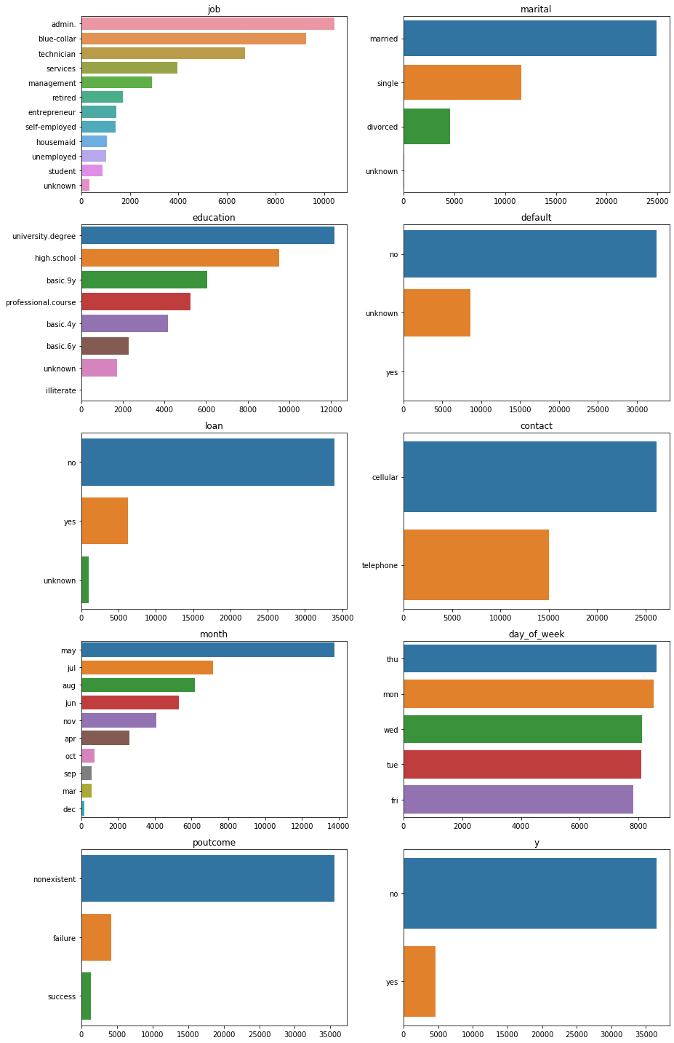
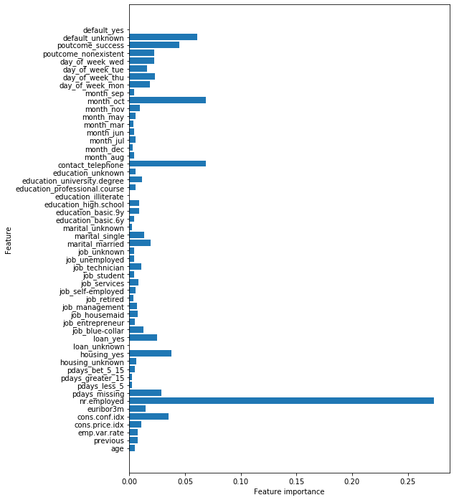
Variable Analysis and feature importance

